Slide 1
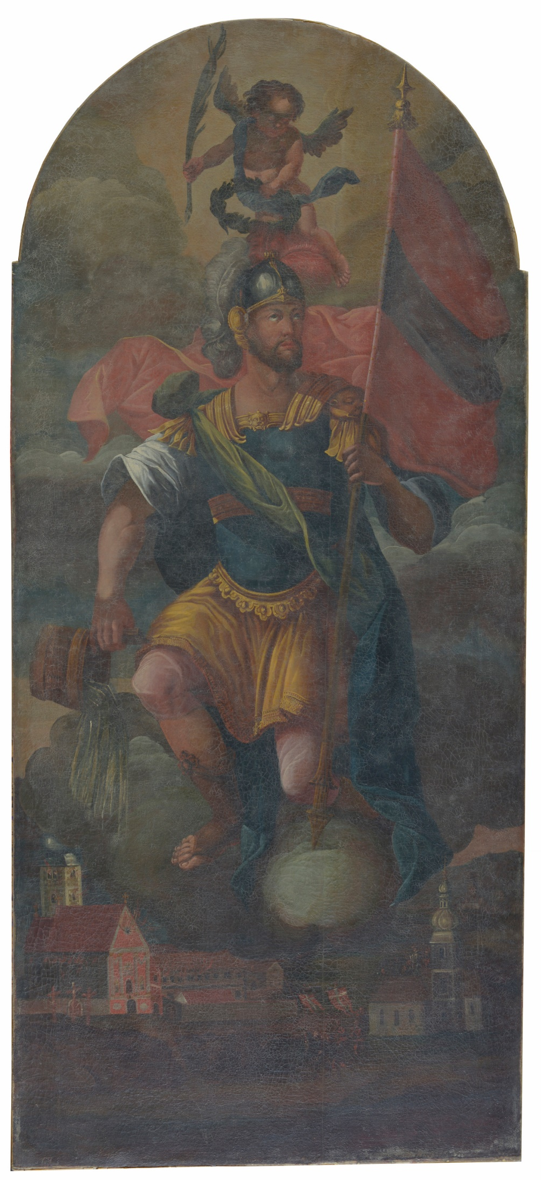
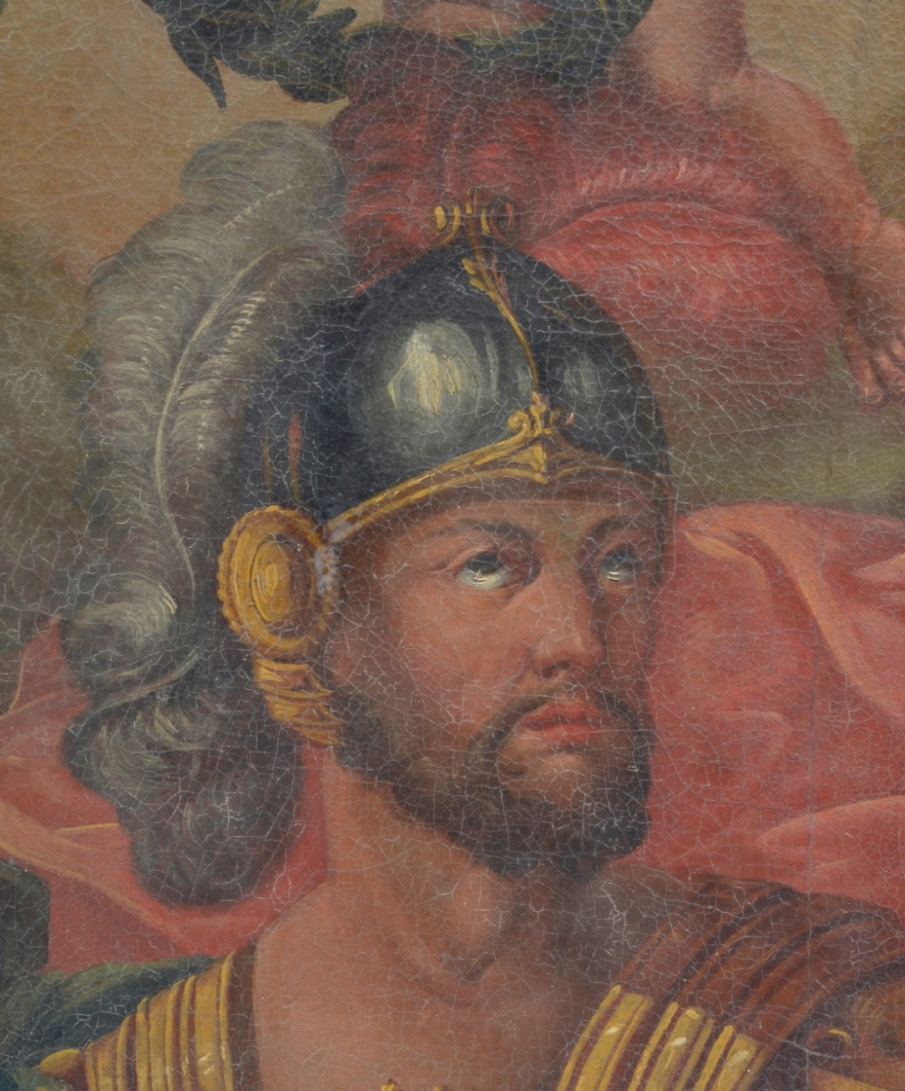
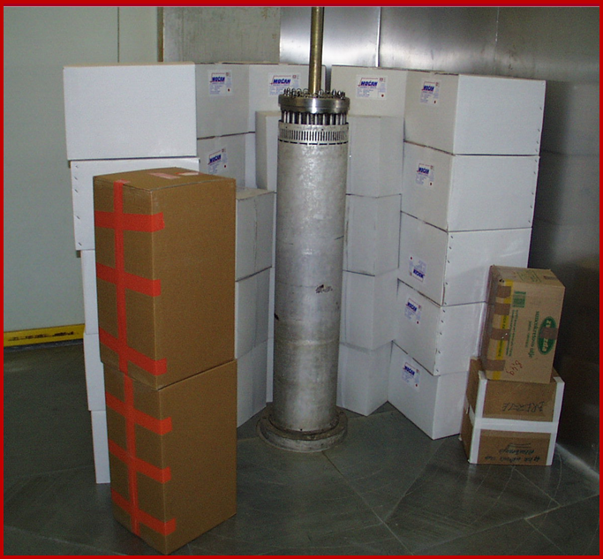
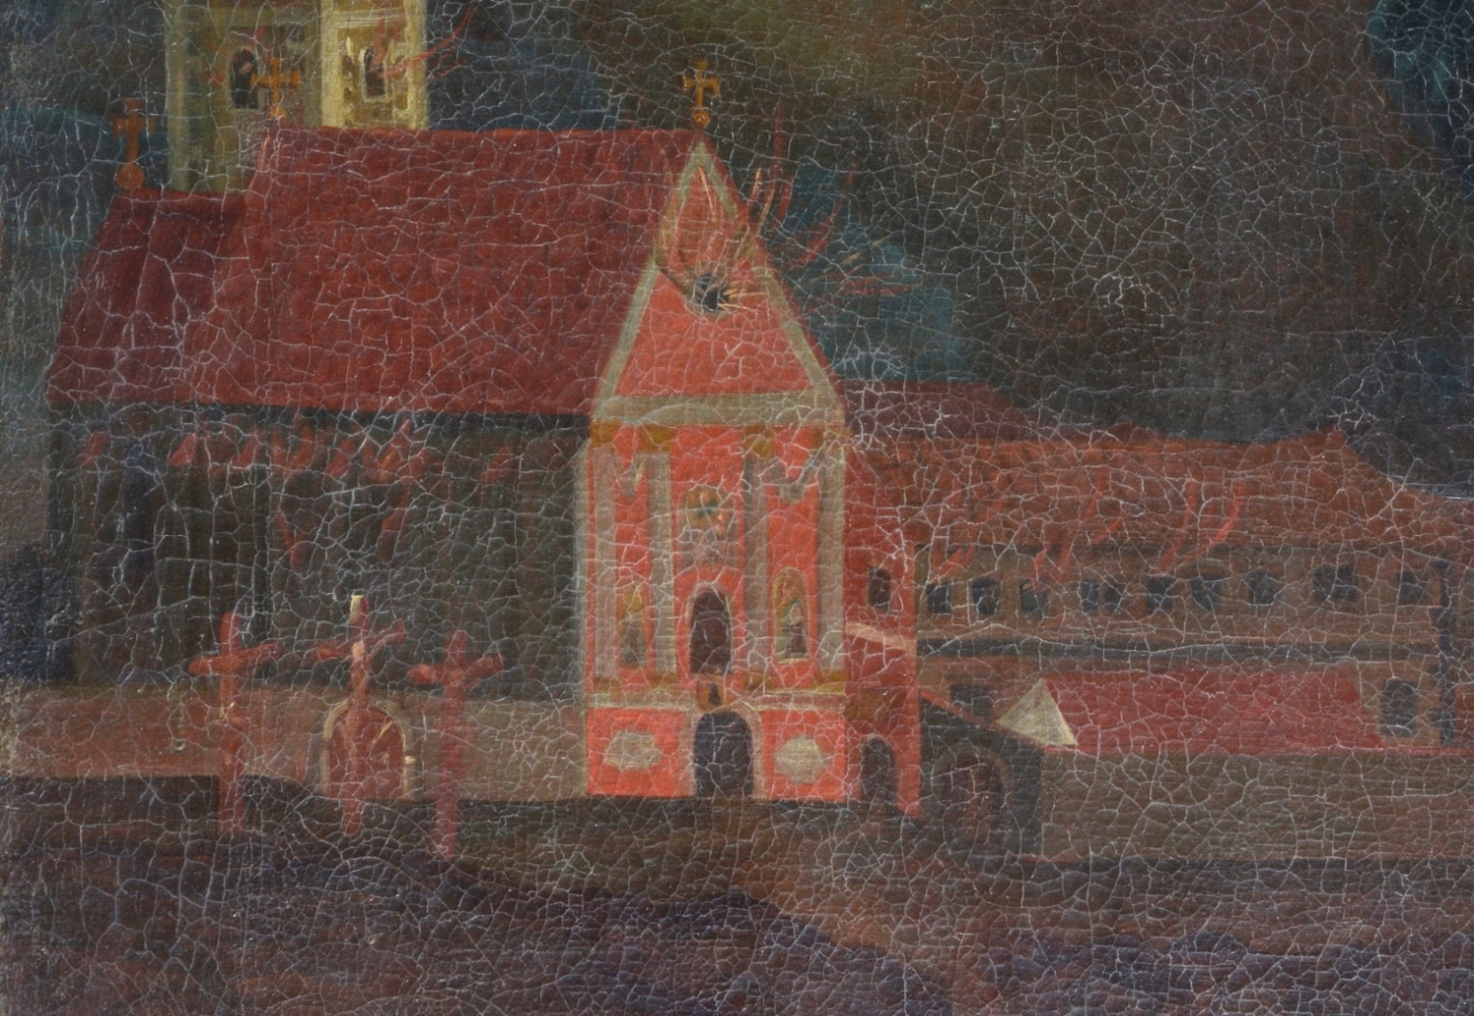
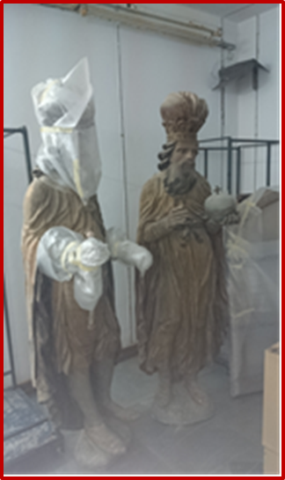
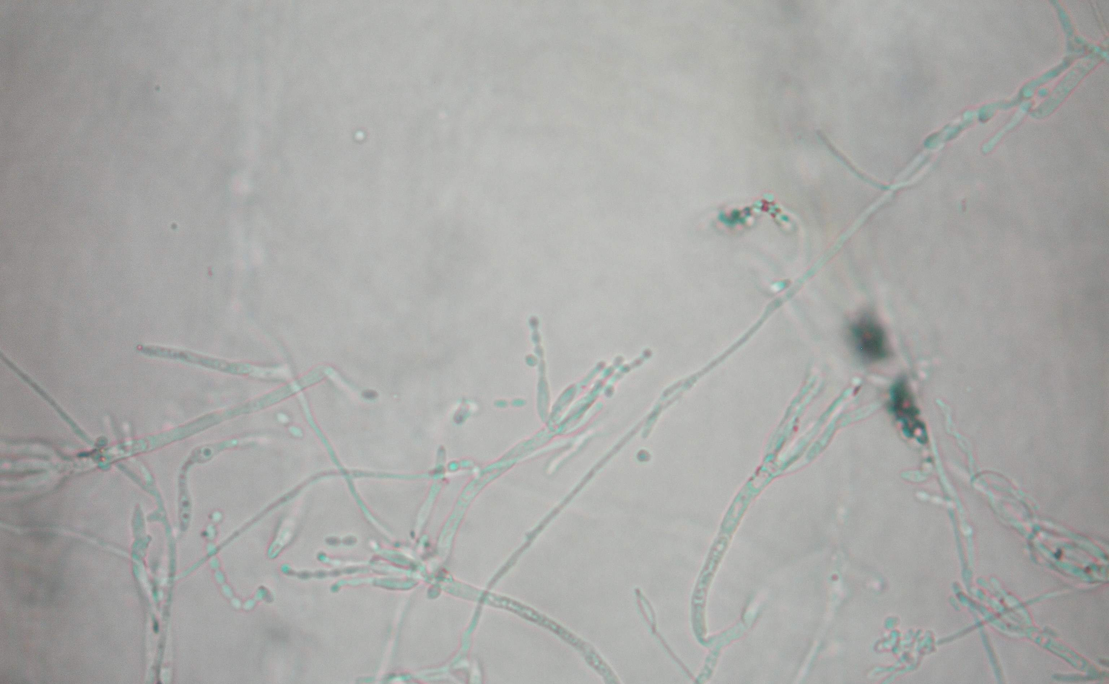
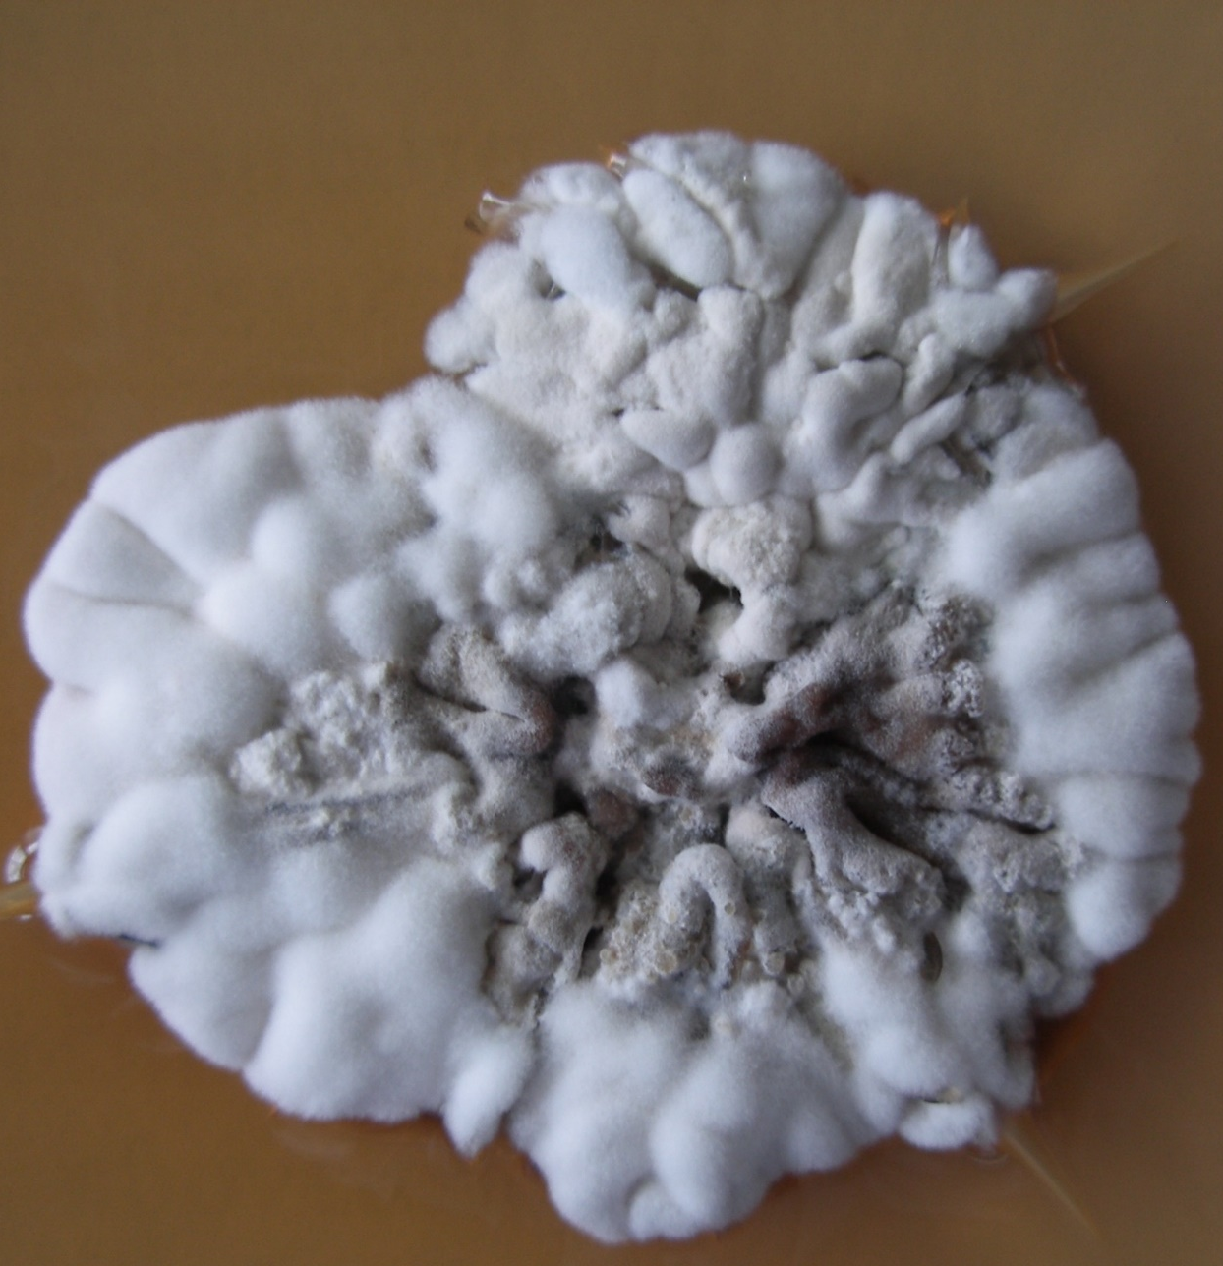
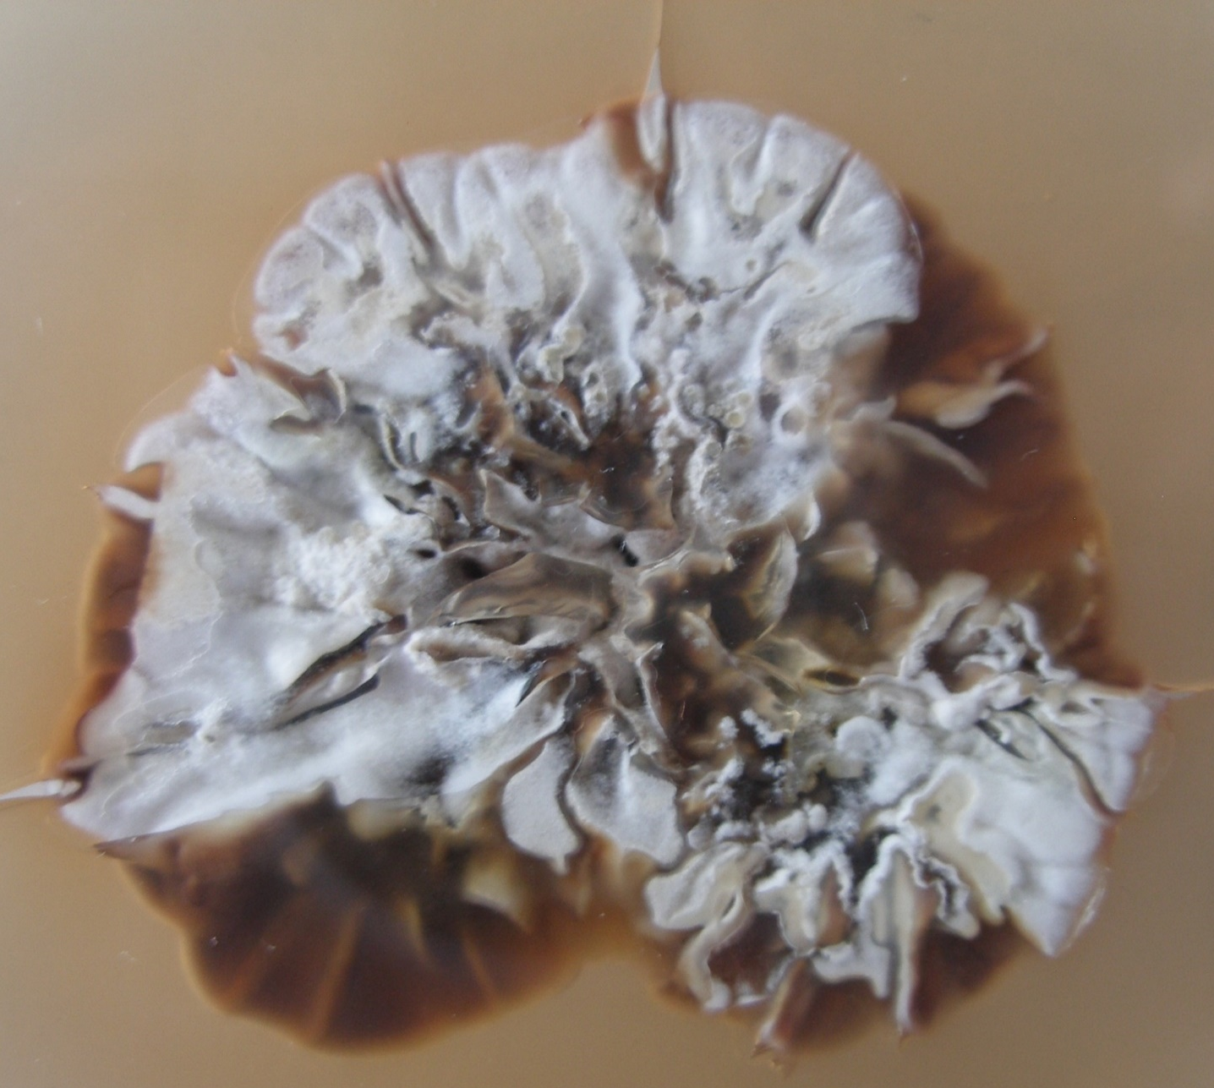
<a
PROTECTION OF CULTURAL HERITAGE OBJECTS BY IONIZING RADIATION
A case study on an oil canvas painting from the 18th century
Katarina Marušić¹, Maja Šegvić Klarić², Ana Dumbović³and Branka Mihaljević¹
¹Ruđer Bošković Institute, Bijenička c. 54, 10000 Zagreb
²Faculty of Pharmacy and Biochemistry, A. Kovačića 1, 10000 Zagreb
³Croatian Conservation Institute, N. Grškovića 23, 10000 Zagreb
e-mail: kmarusic@irb.hr
Introduction
Painting on canvas „St. Florian” by autors Izaija Gasser and assistant
Dating: around 1750
Author: Izaija Gasser and assistant
Dimensions: 245 x 114 cm
Location: treasury of the parish Church of Assumption of the Blessed Virgin Mary in Kloštar Ivanić
Technique: oil on canvas
During 2013 a layer of white mould covered the surface of the paintings paint layer.
Cultural heritage objects of organic origin such as wood, leather, paper and textiles, are subject to degradation due to biological activity of various parasites. Numerous items can be threatened by the appearance of mould and fungi, caused by increased concentration of moisture in the space in which they are located. Radiation methods i.e. the process of intentional exposure of vulnerable subjects to gamma radiation, has already proved to be very effective in saving objects of cultural heritage.
A painting should be considered as a complex system with a lot of interfaces. Therefore in the process of protection of cultural heritage objects the interdisciplinary approach is necessary where besides the microbiological analysis the impact of irradiation on the paintings must be studied at the molecular level.
This paper will outline the necessity of an interdisciplinary scientific approach, as well as the radiation method as the best choice to solve the problem of mould elimination on the original artwork example in cooperation with the Croatian Conservation Institute.
Irradiation device at the Radiation Chemistry and Dosimetry Laboratory (RCDL), Ruđer Bošković Institute
Microbiology analysis
Swab from the painting was inoculated on Malt Extract Agar (MEA), which is suitable for growth of most moulds, and Dichloran Glycerol (DG-18) Agar which is suitable for growth of xerophilic fungi and yeasts.
After 10 days of incubation at 25°C colony growth was recorded. Based on the macro- and micromorphology it was determined to be mould from the genus Penicillium. After subcultivation on Czapek Yeast Extract Agar (CYA) it was determined to be the type of Penicilium from the section Aspergilloides.
Little brushes of penicilium in the native preparats 800x magnified
RCDL has a panoramic multifunction device for irradiation with ⁶⁰Co γ-rays. Radiation field topography was measured using ethanol-chlorbenzen dosimetry system (ISO/ASTM 51538:2009).
The device is used mostly for scientific purposes, and commercial irradiation of medical supplies, pharmaceuticals, cosmetic materials and decontamination and disinfestation of food. Recently, the device has increasingly been used for the preservation and protection of cultural heritage artefacts.
“St. Florian” painting was irradiated on demand of the Croatian Conservation Institute with nominal dose for desinsection of 2 kGy, at a dose rate of 20 mGy/s and chamber temperature 15 °C. Before and ten days after irradiation microbiological analysis was performed and the moulds were isolated.
Penicillium spp. (section Aspergilloides) on CYA after 3 weeks of incubation at 25°C
Reverse side of the colony Penicillium spp. on CYA
Conclusions
Before restoration and conservation the canvas oil painting “St. Florian” from the treasury of the parish Church of Assumption of the Blessed Virgin Mary in Kloštar Ivanić was treated with 2 kGy for radiation desinsection. Ten days after treatment microbiological analysis of the painting showed presence of genus Penicilium from the section Aspergilloides. According to the radioresistivity data of this type of mould available in literature disinfection of this mould could be carried out with 10 kGy, without negative consequences on the materials that are present on the painting (textiles, wood, pigments, binders, wax). Since the painting was already irradiated with 2 kGy the recommended dose for effective radiation decontamination of mould on this painting should be 6-8 kGy.
A painting should be regarded as a complex system of different materials. Therefore within the process of protecting a cultural heritage object an interdisciplinary approach is necessary, in which the microbiological analysis as well as the influence of irradiation on artistic paintings has to be studied on the molecular level.
[1] Katušin-Ražem, B., Ražem, D., Braun, M. Radiat. Phys. Chem. 2009; 78: 729-731.
[2] Pucić, I., Kavkler, K., Mihaljević, B. Second International Conference on Radiation and Dosimetry in Various Fields of Research, Book of Abstracts, Niš, Faculty of Electronic Engineering, 2014, 171.

